Slide 1


Intro to for ASP.NET Developers
Matt Honeycutt
@matthoneycutt
http://trycatchfail.com

Slide 2
What did I sign up for??
We’ll cover…
But we won’t get in to…
Crash-course on AngularJS
Using components with ASP.NET MVC & Web API
UI Bootstrap
Client-side build tools
Angular < 1.5
Angular 2.0!
ASP.NET basics

Slide 3

Which version of AngularJS?

Slide 4
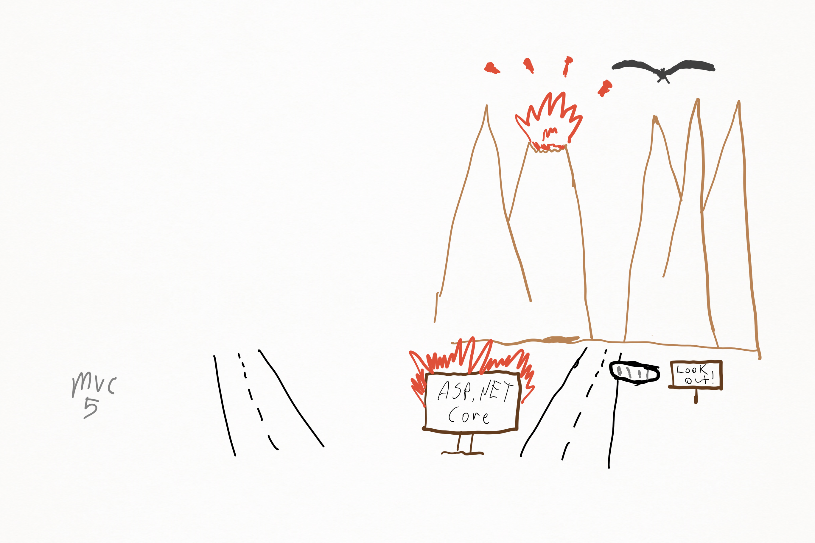
Which version of ASP.NET?

Slide 5
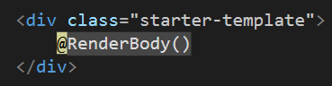
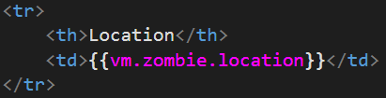
AngularJS (1.5) Overview
ASP.NET
AngularJs
M
V
C

Slide 6
AngularJS (1.5) Overview
module
controller
directive
component
constant
value
service, factory, provider…
filter

Slide 7
AngularJS (1.5) Overview
module
controller
directive
component
constant
value
service, factory, provider…
filter

Slide 8
AngularJS (1.5) Overview
module
controller
directive
component
constant
value
service, factory, provider…
filter

Slide 9
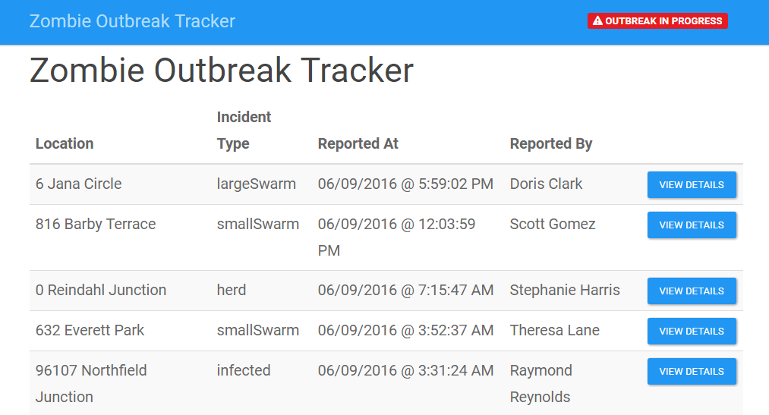


The Zombie Apocalypse is coming…

Slide 10
DEMOS!!!

Slide 11

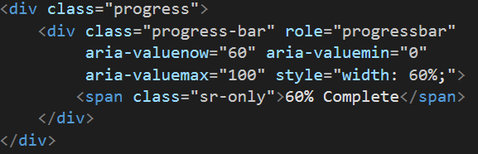
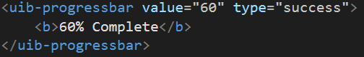
UI Bootstrap
“Bootstrap components written in pure AngularJS…”

Slide 12
DEMOS!!!

Slide 13
How do I get started?
Use Angular for two-way binding
Build a silo’d SPA
Learn a client-side build tool
Go all in: build a SPA!

Slide 14


Next Steps


SAMPLE CODE
STYLE GUIDE
CONSULTING
BLOG
https://goo.gl/yUB5oD
https://goo.gl/ztMMWq
mbhoneycutt@gmail.com
http://trycatchfail.com

